Slide 1


Slide 2

BUSINESS ETIQUETTE - 7

Slide 3
Headlines: The Unsung Heroes of Business Etiquette

Slide 4
Preface
In the fast-paced world of business, where attention spans are shorter than ever, first impressions are everything.
A well-crafted headline is more than just a title; it's a promise of value, a spark of curiosity, and a strategic gateway to your message. It's the first touchpoint between you and your audience, and it sets the tone for the entire interaction.
Let's explore how this seemingly small element can significantly impact your business etiquette and overall professional success

Slide 5

Catchy and Short Headlines in Business
A catchy headline is a concise and compelling phrase that grabs attention and entices readers to learn more. In business, it's the first impression that can make or break a piece of content. A catchy headline should:
Evoke curiosity: Spark interest and make readers wonder what's inside.
Promise a benefit: Clearly communicate the value proposition.
Create urgency: Encourage immediate action or attention.
Reflect the content: Accurately represent the topic or message

Slide 6

Catchy and Short Headlines in Business
Short headlines are concise and to the point. They are essential in today's fast-paced digital world where attention spans are limited. A short headline should:
Be clear and direct: Convey the main message quickly.
Use strong verbs: Create a sense of action and urgency.
Be easy to scan: Use keywords and power words effectively.
Fit within character limits: Adhere to platform requirements (e.g., social media, email).
In essence, a catchy and short headline is a powerful combination that can significantly impact a business's success.

Slide 7

Importance of a strong headline
Grabs attention: A compelling headline is essential to stand out in a crowded digital landscape.
Conveys key information: It quickly communicates the main idea or focus of the content.
Influences click-through rates: A well-crafted headline encourages readers to click and explore the content further.
Sets expectations: It provides a preview of what readers can expect to learn or gain from the content.

Slide 8

Role of headlines in different contexts
News: Headlines inform readers about the most important aspects of a news story and prioritize key details.
Marketing: Headlines are used to promote products, services, or brands, aiming to generate interest and drive conversions.
Social media: Headlines on social media platforms must be concise and engaging to capture attention in a limited character count.

Slide 9

Role of headlines in different contexts
News
Informative: Headlines in news articles convey the core message of the story quickly and accurately.
Urgent: They often create a sense of immediacy or urgency to attract readers.
Objective: News headlines strive to be unbiased and factual.

Slide 10

Role of headlines in different contexts
Marketing
Persuasive: Marketing headlines aim to convince potential customers to take a desired action (e.g., purchase, sign up).
Benefit-oriented: They focus on highlighting the advantages of a product or service.
Call to action: Effective marketing headlines often include a clear call to action (e.g., "Shop Now," "Learn More").

Slide 11

Role of headlines in different contexts
Social Media
Engaging: Social media headlines need to grab attention instantly due to the fast-paced nature of the platform.
Short and sweet: Character limits necessitate concise and impactful headlines.
Shareable: Headlines that evoke emotions or curiosity are more likely to be shared.

Slide 12
The Power of a Strong Headline
Stop the scroll: A compelling headline interrupts the endless feed and forces readers to pause.
Create curiosity: A well-crafted headline sparks interest and makes readers want to know more.
Promise value: A headline that clearly communicates benefits can entice readers to click.
Higher click-through rates: Strong headlines directly correlate with increased clicks.
Improved engagement: A relevant headline leads to higher engagement metrics (e.g., time spent on page, shares).
Boosted conversions: For marketing content, a compelling headline can drive more sales or leads.

Slide 13
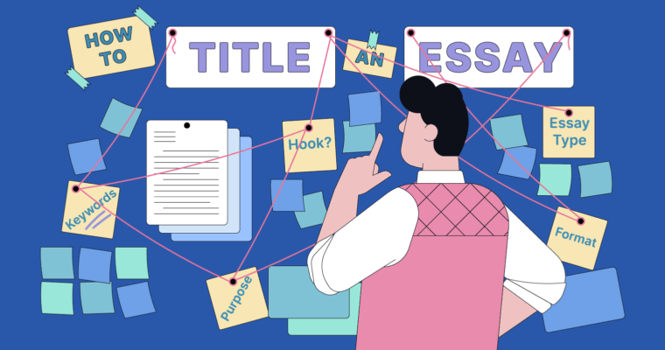
Key Elements of a Catchy Headline
Clarity and conciseness
Strong verbs
Benefit-oriented language
Use of numbers and power words
Creating curiosity and intrigue

Slide 14
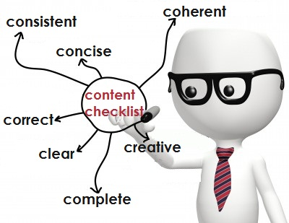
Key Elements of a Catchy Headline
Clarity and conciseness
Get to the point: Clearly communicate the main idea of your content.
Keep it brief: Avoid unnecessary words and jargon.
Prioritize keywords: Include relevant keywords for SEO and clarity.
Strong verbs
Create action: Use powerful verbs to evoke emotion and interest.
Be specific: Choose verbs that accurately describe the content.
Examples: Discover, Uncover, Master, Transform

Slide 15

Key Elements of a Catchy Headline
Benefit-oriented language
Focus on the reader: Highlight how the content will benefit the audience.
Use persuasive language: Convince readers of the value proposition.
Examples: Save time, Increase profits, Improve your health
Use of numbers and power words
Create urgency: Numbers add credibility and create a sense of urgency.
Leverage power words: Use emotionally charged words to grab attention.
Examples: Ultimate, Proven, Exclusive, Breakthrough

Slide 16

Key Elements of a Catchy Headline
Creating curiosity and intrigue
Ask a question: Spark curiosity with a thought-provoking question.
Use unexpected elements: Surprise readers with something unusual.
Create a sense of mystery: Hint at something valuable without revealing too much.

Slide 17
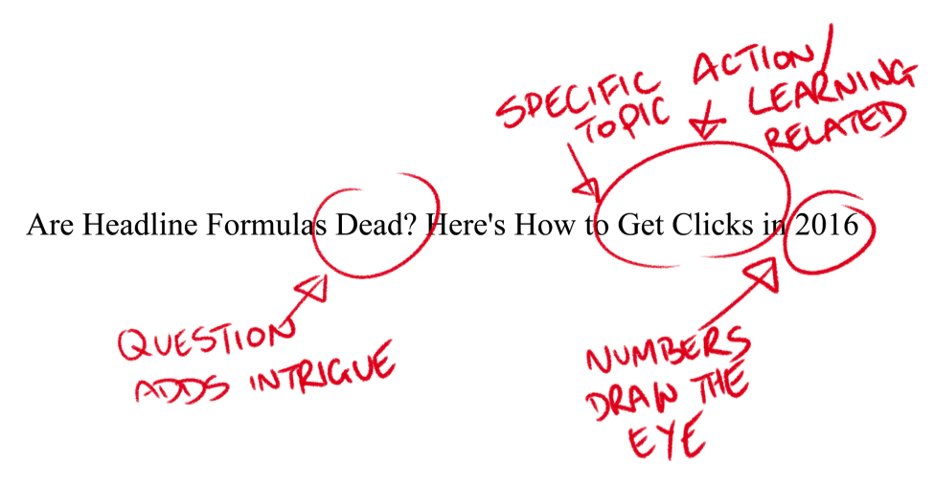
Headline Formulas
How-to: Provides a solution or guide to a problem.
Question: Creates curiosity and encourages clicks.
List: Outlines key points or benefits.
Numbered list: Offers specific value or steps.
Benefit-driven: Focuses on the outcome or advantage.
Command: Tells the reader to do something.
Curiosity gap: Creates intrigue and a desire to know more

Slide 18
Writing Effective Headlines
Brainstorming Techniques
Keyword brainstorming: Identify relevant keywords related to your content.
Mind mapping: Visually connect ideas and explore different angles.
Free writing: Write down any thoughts or ideas that come to mind.
Competitive analysis: Analyze headlines of successful competitors.
Keyword Research
Identify target keywords: Determine the words and phrases your audience is searching for.
Use keyword research tools: Utilize tools like Google Keyword Planner, SEMrush, or Ahrefs.
Incorporate keywords naturally: Avoid keyword stuffing and focus on readability.

Slide 19
Writing Effective Headlines
A/B Testing
Create multiple headline variations: Test different headlines to see which performs best.
Track performance metrics: Measure click-through rates, engagement, and conversions.
Analyze results: Identify winning headlines and apply learnings to future campaigns.
Considering the Target Audience
Understand your audience
Define their needs, interests, and pain points.
Use their language: Speak to your audience in a language they understand.
Tailor headlines to specific demographics: Create headlines that resonate with different groups

Slide 20

Headline length
The length of your headline significantly impacts readability:
Short headlines: Easier to scan and comprehend quickly.
Long headlines: Can provide more context but might overwhelm readers.
Balance: The ideal length depends on the platform and content. Strive for clarity while maintaining interest.
.

Slide 21

Headline length
Search Engine Results (SERPs): Aim for 50-60 characters to ensure your headline displays fully without being truncated.
Social Media
Twitter: Given its character limit, aim for 280 characters or less, ideally shorter.
Facebook: Around 40-50 characters for optimal visibility.
Instagram: While you can use up to 125 characters, shorter headlines generally perform better.
LinkedIn: 50-60 characters is recommended for maximum visibility.
News Headlines: Traditionally shorter, aiming for 5-8 words is common.
Blog Titles: Can be slightly longer, but aim for 60 characters or less for better readability

Slide 22

Common Headline Mistakes
Overusing Clichés
Problem: Clichés are overused phrases that lack originality and impact.
Solution: Use fresh language and unique expressions to stand out.
Being Too Vague or Generic
Problem: Vague headlines fail to provide clear information or benefits.
Solution: Be specific and focus on providing clear value to the reader.

Slide 23

Common Headline Mistakes
Making False Promises
Problem: Exaggerated or misleading claims can damage credibility.
Solution: Be honest and realistic in your headline.
Using Excessive Exclamation Points
Problem: Overuse of exclamation points can appear unprofessional and spammy.
Solution: Use exclamation points sparingly and only when necessary to emphasize a point.

Slide 24
QUESTION 1
What is the primary purpose of a press release in business etiquette?
To announce personal achievements
To provide updates on company events and developments
To share gossip about competitors
To criticize industry partners
Notes:
ANS:b

Slide 25
QUESTION 2
Which of the following should be included in the headline of a press release?
Lengthy paragraphs detailing company history
Eye-catching and concise summary of the news
Personal opinions about the subject
Technical jargon unfamiliar to the audience
Notes:
ANS:b

Slide 26
QUESTION 3
When writing a press release, what should be the tone used to maintain professionalism?
Casual and colloquial
Informative and objective
Sarcastic and humorous
Emotional and dramatic
Notes:
ANS:b

Slide 27
QUESTION 4
What is the ideal length for a press release in business etiquette?
Several pages
One to two sentences
500 words or less
As long as necessary to include all details
Notes:
ANS:c

Slide 28
QUESTION 5
What should be included in the boilerplate section of a press release?
Contact information and a brief company description
Personal opinions of the writer
Details of the author's vacation plans
A list of random facts about the company
Notes:
ANS:a

Slide 29
QUESTION 6
When taking meeting notes, what is the recommended approach to ensure accuracy?
Relying solely on memory
Using shorthand and abbreviations
Recording the meeting on a smartphone
Asking colleagues to provide their notes after the meeting
Notes:
ANS: b

Slide 30
QUESTION 7
Which of the following should be included in meeting notes to ensure completeness?
Only the topics that interest the note-taker
Detailed summaries of discussions and decisions
Personal opinions about attendees
Irrelevant information unrelated to the meeting agenda
Notes:
ANS:b

Slide 31
QUESTION 8
How should action items be documented in meeting notes?
Ignoring them entirely
Listing them without assigning responsibility
Clearly identifying tasks, deadlines, and responsible parties
Writing vague descriptions to leave room for interpretation
Notes:
ANS:c

Slide 32
QUESTION 9
What should be done with meeting notes after the meeting is concluded?
Throwing them away
Sharing them with only a select few
Distributing them to all meeting attendees
Keeping them confidential
Notes:
ANS: c

Slide 33
QUESTION 10
How can meeting notes contribute to business etiquette? A) By providing a record of agreements and actions
B) By including personal opinions and biases
C) By excluding important details to save time
D) By using complex language to confuse readers
Notes:
ANS:A

Slide 34
THANK YOU

